Slide 1
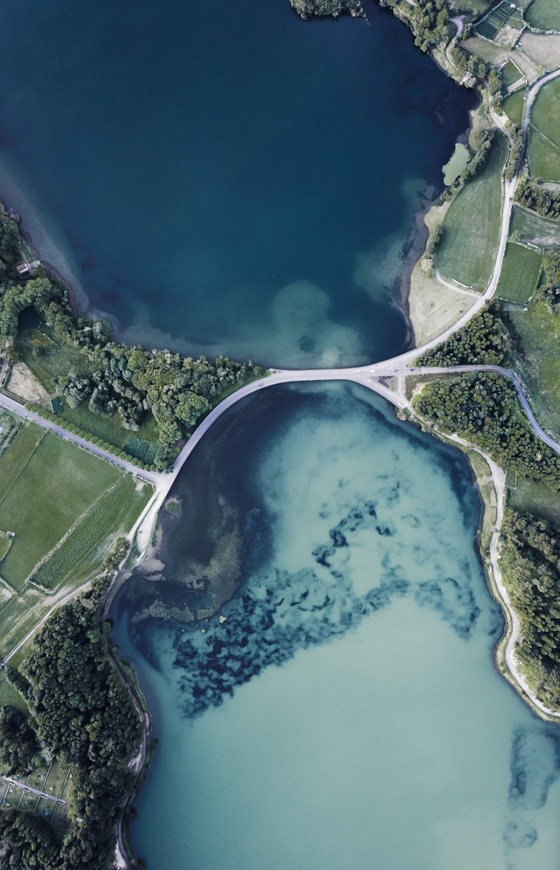


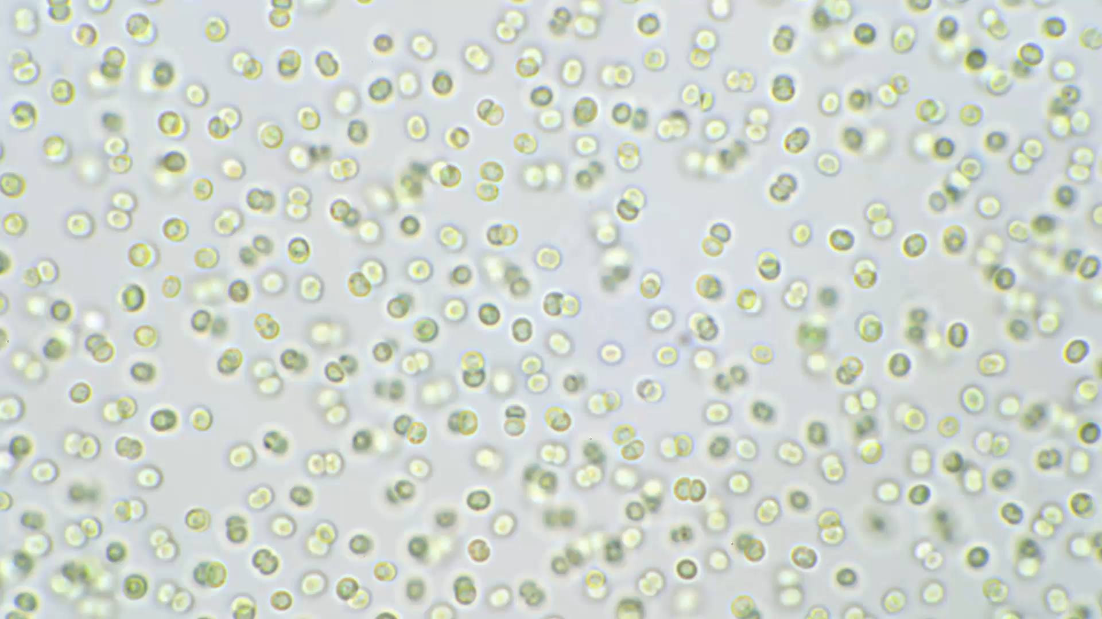
Applying Design of Experiments and Machine Learning algorithms to define the consumption envelope of lactic acid
Marc Garcia Lopez
Photanol - Universitat Oberta de Catalunya
2022-2023

Slide 2
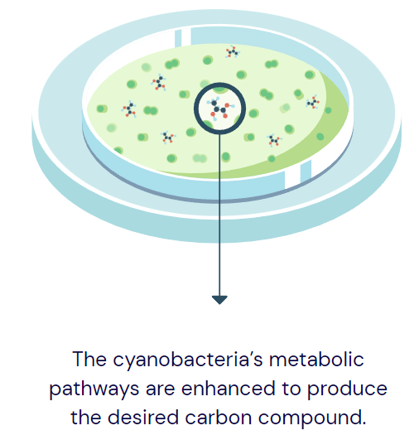
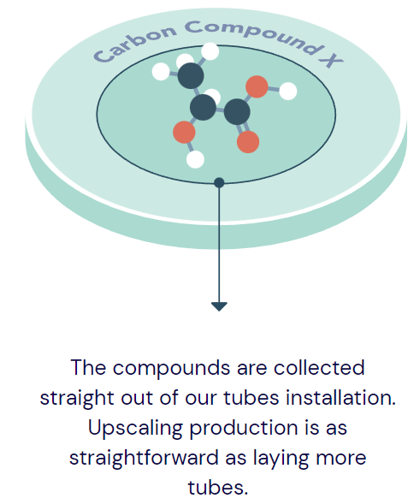
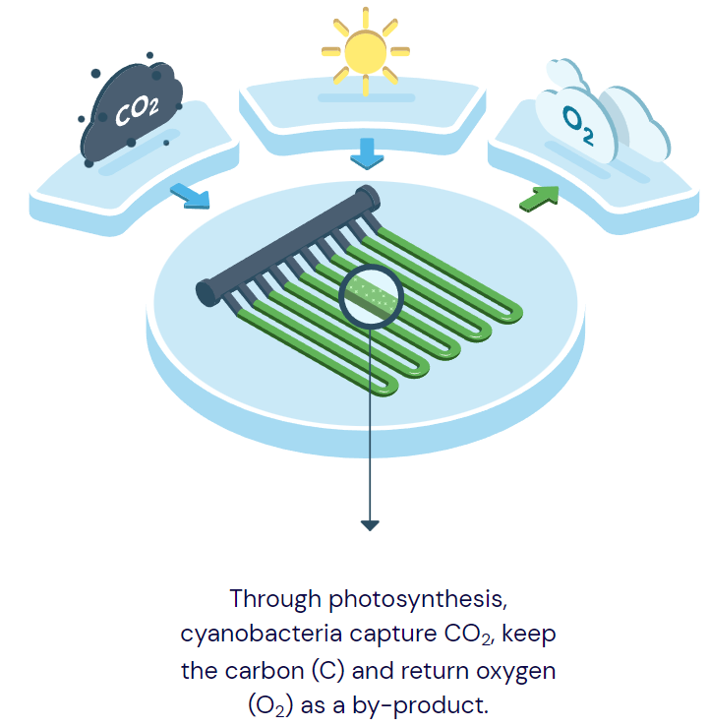
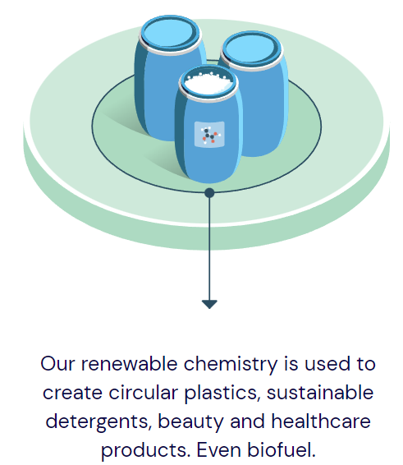
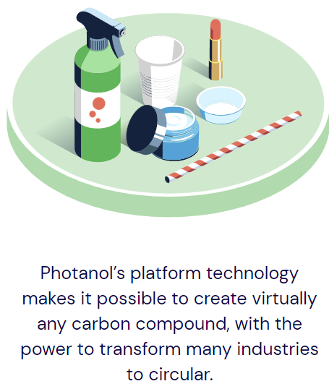
Photanol’s approach
Photanol
Confidential

Slide 3

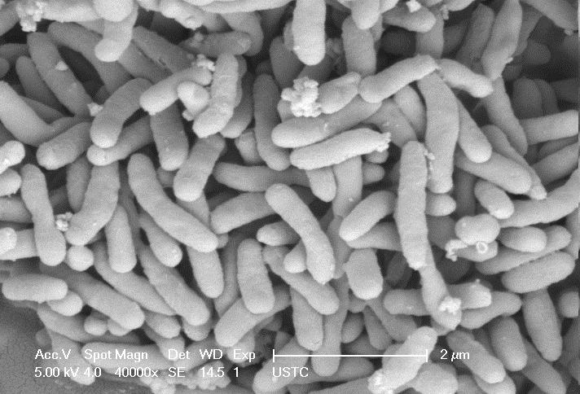
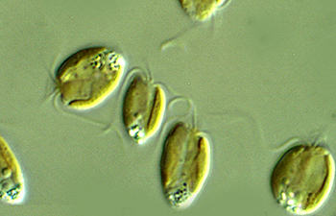
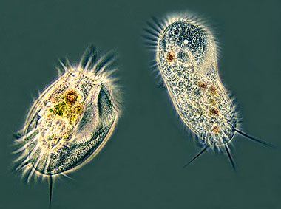
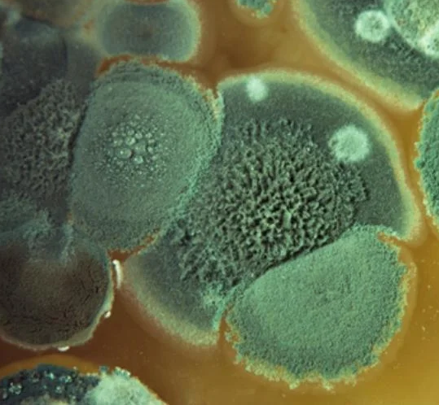
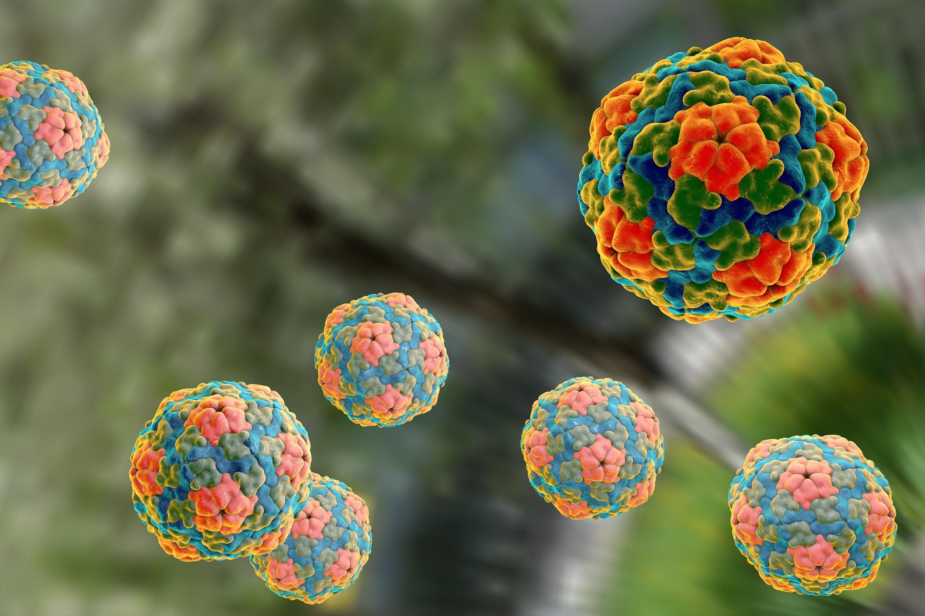
The problem
Other algae
Zooplankton
Product consuming bacteria
Fungi
Viruses
Compete for nutrients
Consume the bio-products (SMP)
Sudden crashes
PBR contaminated with biological pollutants
Confidential

Slide 4
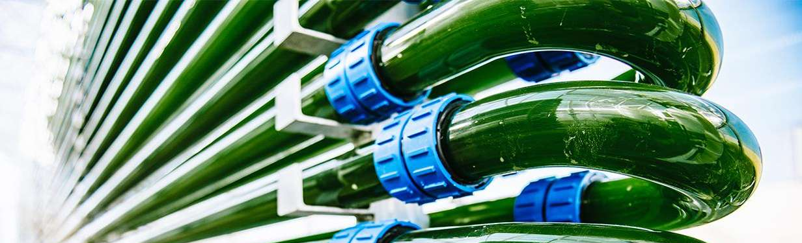
before we start…
pH 11 alone* is not enough to prevent lactate consumption.
Alone**, moderate osmolarities (π ≤ 0.5 M NaCl) are not enough to prevent glycolate consumption.
Confidential
* T ≈ 30, π = 0 M NaCl
** T ≈ 30, pH ≈ 9

Slide 5


Goal
COST:
Unnecessarily high number of experiments.
Does not consider the interaction between factors.
B) FFD:
Unfeasible number of experiments.
C) DoE + OLS regression:
Not the best for non-linear data.
Not adequate for zero-inflated data.
D) DoE + other regression methods:
ZIP Poisson, ZIP Negative Binomial, Random Forest.
F) DoE + hybrid models (classifier + regressor):
E) DoE + ML classification:
aaa
Find those combinations of temperature (T), pH and osmolarity (π) that inactivate the biological pollutants and, therefore, prevent the consumption of lactate in our PBRs.
pH | T [˚C] | π [M NaCl] | β [mM lactate/day]
10.5 | 30 | 0.3 | 20.18
… | … | … | …
11.5 | 50 | 1 | 0
Predictors
Response
Photanol
Confidential

Slide 6
Pipeline
Exploratory Data Analysis (EDA)
Selection of the adequate method

Slide 7
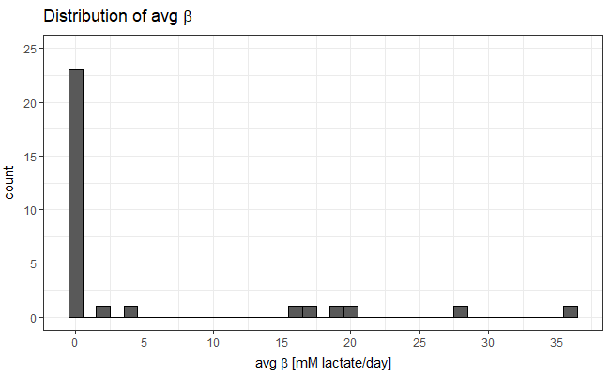
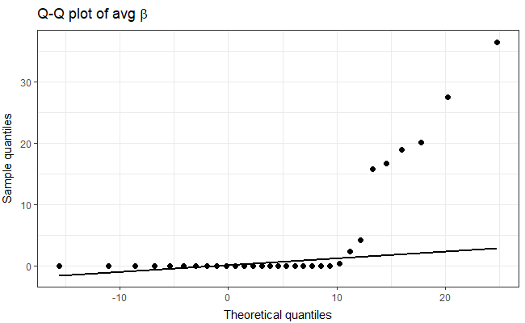
Exploratory data analysis

Slide 8
Selected ML algorithms
Random Forests
Artificial neural Networks
Support Vector Machines
Multiple linear regression
Regression/Classification
Low influence of outliers
Good for big datasets
Good when class imbalance
Can handle colinearilty
Overfitting
Strong computational power required
Regression/Classification
Low influence of outliers
Suffer from class imbalance
Strong computational power required.
Regression/Classification
Effective for high dimensional spaces
Memory efficient
Bad for big datasets
High influence of outliers
Suffers from class imbalance
Simple but effective
Regression
Sensible to outliers
Cannot handle colinearity
In general worse results

Slide 9

Experimental design
Media/Inoculum:
Set-up:
Applikon
PSI
Cultivation conditions:
Air flow:
300 mL/min (A)
200 mL/min (P)
Agitation:
300 rpm (A)
100% (P)
pH control:
NaOH 2 M (A)
NaOH 1-1.5 M (P); 150-200 µL/min
Validation
Normal conditions (NC):
Stringent conditions (SC):
Medium:
2x BG11+ 50 mM lactate + 5mM TES + 5% LB
Inoculum:
Raw samples pilot (10⁷ – 10⁸ cfu/mL)
Medium:
1x BG11 + 50 mM lactate + 5 mM TES
Inoculum:
Raw samples pilot (10³ – 10⁴ cfu/mL)
WT (OD₇₃₀= 2)

Slide 10

Why building a model?
Amongst others…
Identifying patterns that humans might overlook
Predicting the outcome of unseen conditions with a certain accuracy
Lowering the number of experiments
Photanol
Confidential

Slide 11
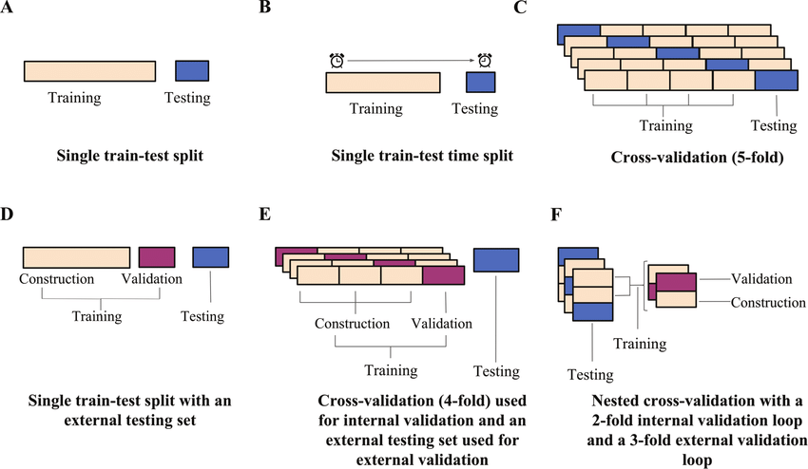
Building the model (2)
Less biased than A, B or D.
Really powerful when the amount of data is limited.
Better overview of the performance of the model.
.

Slide 12
Types of models
Regressors
Classifiers
pH | T [˚C] | π [M NaCl] | Qvcd (mM/d)
10.5 | 30 | 0.3 | 20.18
… | … | … | …
11.5 | 50 | 1 | 0
pH | T [˚C] | π [M NaCl] | Class
10.5 | 30 | 0.3 | 0
… | … | … | …
11.5 | 50 | 1 | 1
Qvcd > 0.1 mM/d
Qvcd < 0.1 mM/d
Predictors
Response
Predictors
Response
RMSE: standard error of the residuals.
R² adj: proportion of the variation of the response explained by our model. (adjusted for the number of predictors).
MAE: mean absolute error (less sensible to outliers).
Accuracy: probably that a condition is labeled correctly.
Sensitivity: probability that a condition labeled as safe it is truly safe.
Specificity: probability that a condition labeled as not safe it is truly not safe.
Kappa: accuracy normalized at the baseline of random chance.

Slide 13
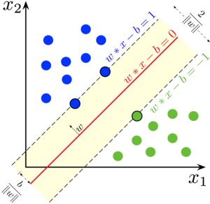
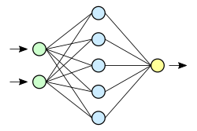
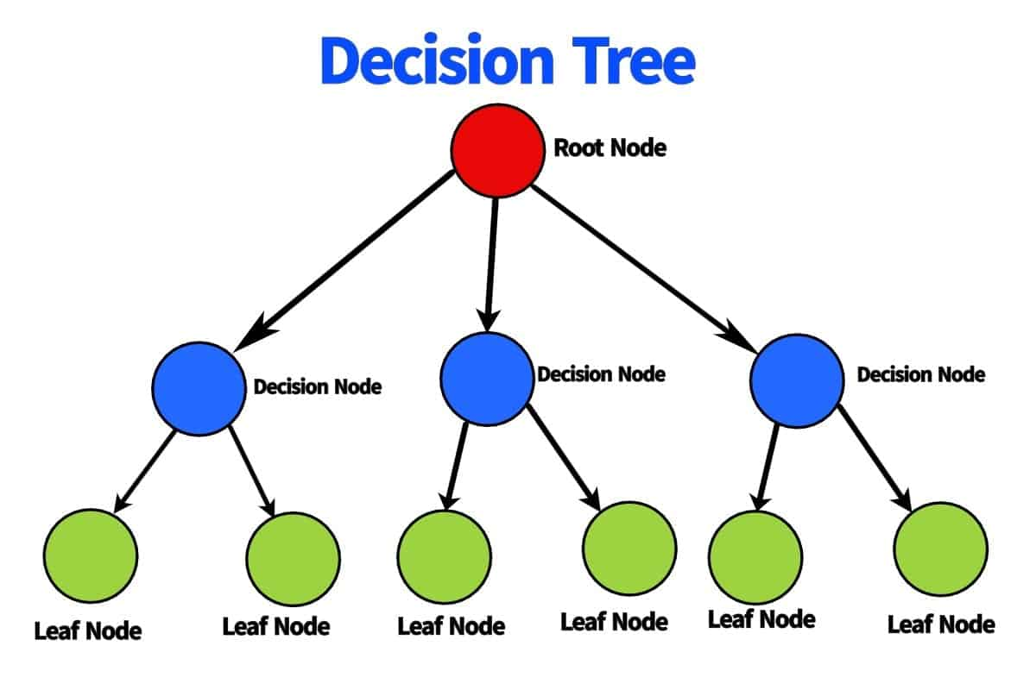
classifiers
Unseen data
Training data
SVM
Accuracy: 0.7-0.8
ANN
Accuracy: 1
Sensibility: 0.8-0.9
Specificity: 0.6-0.7
Kappa: 0.45-0.55
Sensibility: 1
Specificity: 1
Kappa: 1
RF
Accuracy: 0.75-0.85
Sensibility: 0.8-0.9
Specificity: 0.8-0.9
Kappa: 0.55-0.6
Accuracy: 0.7931
Sensibility: 0.7895
Specificity: 0.8
Kappa: 0.56
Low-moderate kappa
Worst model
Accuracy: 1
Sensibility: 1
Specificity: 1
Kappa: 1
Overfitted
Low specificity (training)
Low kappa (training)
Accuracy: 1
Sensibility: 1
Specificity: 1
Kappa: 1
Perfect performance
Best model!

Slide 14
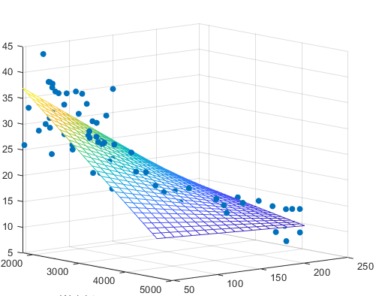
Regressors
Unseen data
Training data
SVR
RMSE: 6.5-12
RF
R²: 0.6-0.9
MAE: 5-11
RMSE: 7.5-13
MLR
RMSE: 7.5-14
R²: 0.5-0.7
MAE: 6.5-11
R²: 0.65-0.85
MAE: 6-10
RMSE: 4.13
R²: 0.89
MAE: 2.81
Slightly overfitted
Good parameters
Extreme predictions
RMSE: 4.78
R²: 0.9
MAE: 3.32
Overfitted
No negative or extreme predictions
Selected model
RMSE: 3.68
R²: 0.9
MAE: 2.99
Slightly overfitted
Good parameters
Extreme predictions

Slide 15
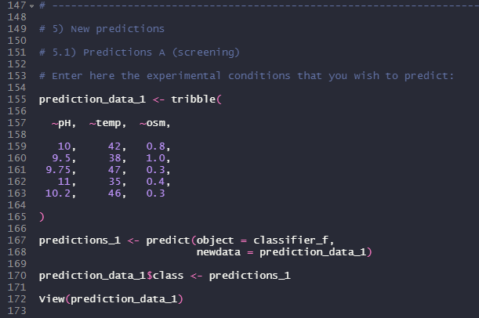
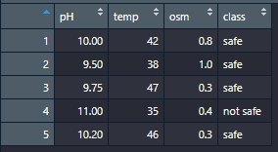
Models’ applications (1)
Validations
Updating the model
"C:/Users/marcg/Photanol bv/Photanol all - students - General/2_Upscaling/2021 Alessia de Maio/5_Operational_envelope/First run (raw samples)/Models/Classification (safe-not safe)/Random Forest/ Random Forest (classification/.r)"

Slide 16
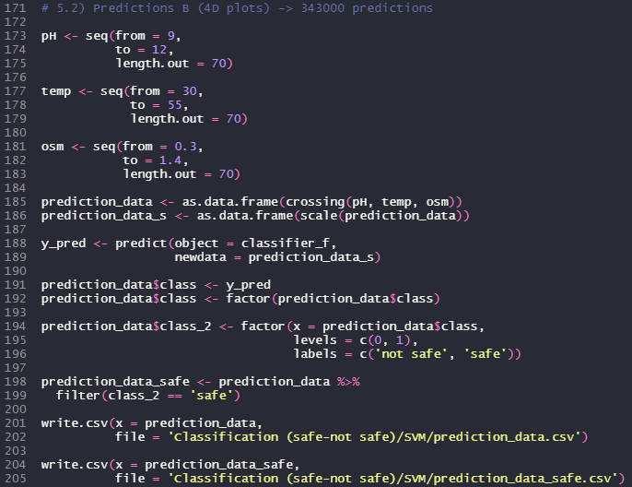
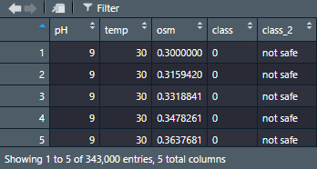
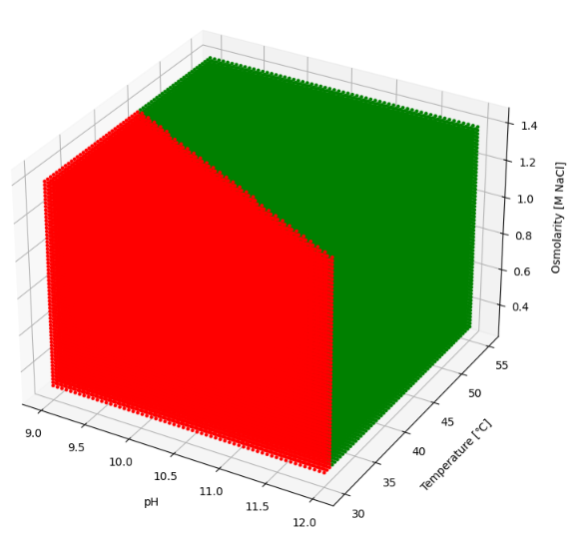
Models’ applications (2)
Visualization (4D plots)
"C:/Users/marcg/Photanol bv/Photanol all - students - General/2_Upscaling/2021 Alessia de Maio/5_Operational_envelope/First run (raw samples)/Models/Classification (safe-not safe)/Random Forest/ Random Forest (classification/.r)"

Slide 17
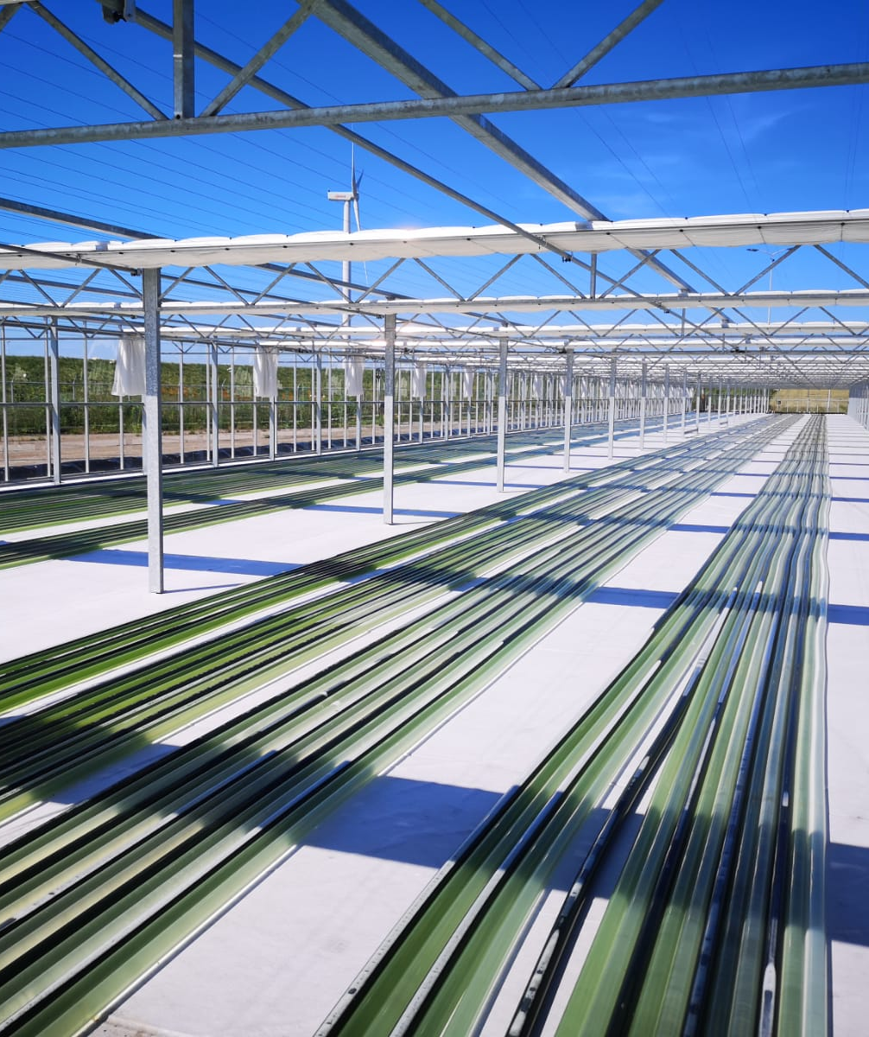
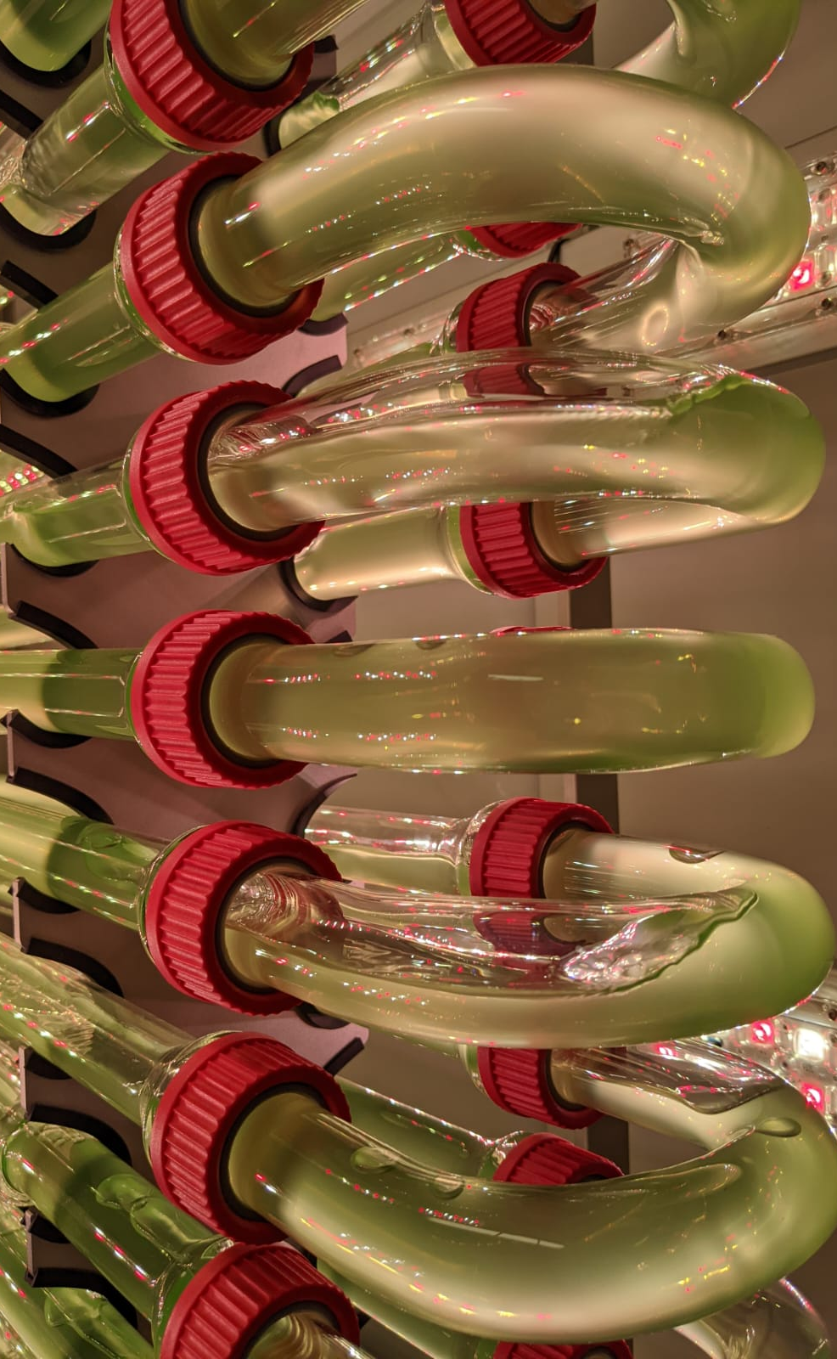
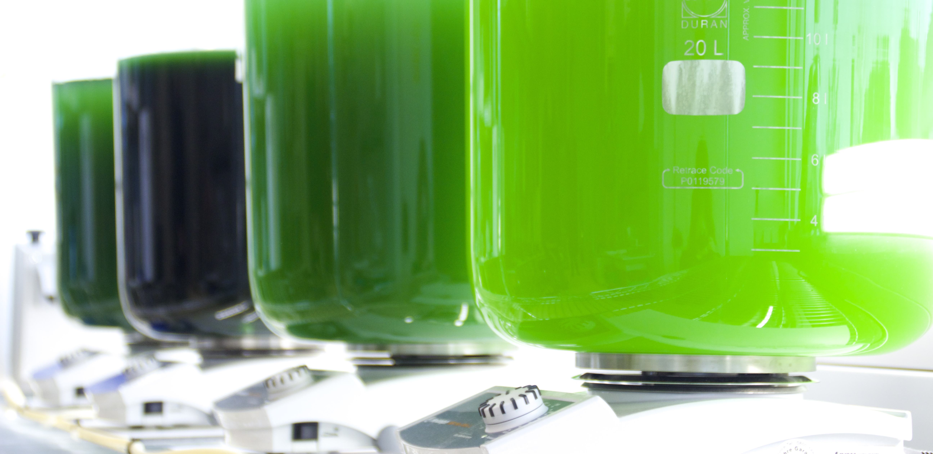
Conclusions
Temperature and pH play the most important role.
Osmolarity plays an essential role when pH and T are low.
At pHs [9.5, 10] temperature must be ≥ 40.
Increasing the salinity can lower this temperature a bit.
pH = 9.5, T = 38, π = 0.7
pH = 10, T = 38, π = 0.3
At pHs ≈ 9 high temperatures are not enough to prevent contamination.
If temperature [38, 55] we need ≥ 0. 6 M NaCl
Confidential

Slide 18
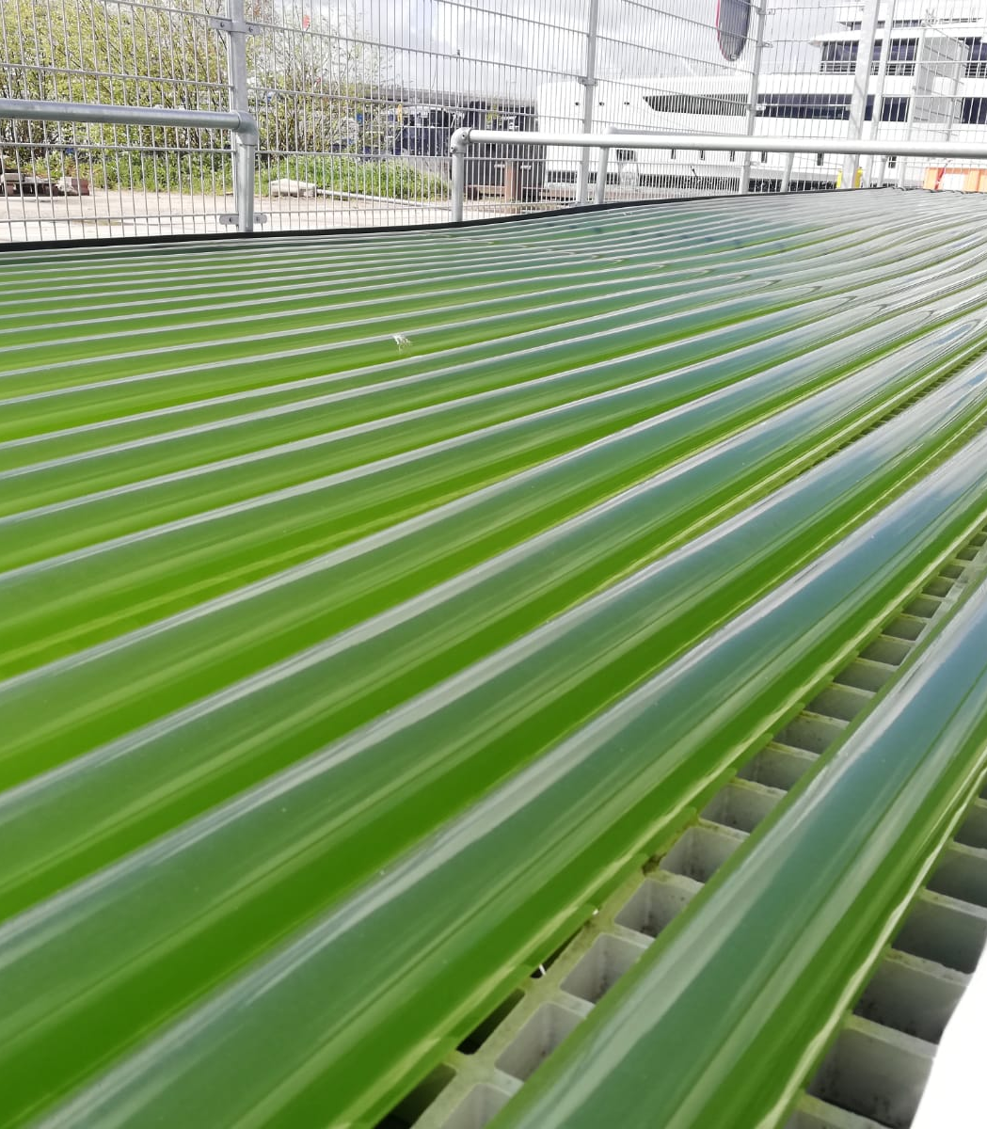
Further steps
Use the models to make predictions over interesting conditions. Validate the predictions and update the models.
Retest some of the conditions with the top 8 isolates:
50/50 raw sample (10³ cfu/mL), isolates (10³ cfu/mL).
Test some of the interesting conditions for glycolate.
Align with the antimicrobial project (emergency measure).
Swing approach.
Confidential

Slide 19
Thank you!
marc.garcialopez@photanol.com
alessia.demaio@photanol.com
https://photanol.com/

